Slide 1

Steel Data
Challenge 4 Finance Analysis

Slide 2
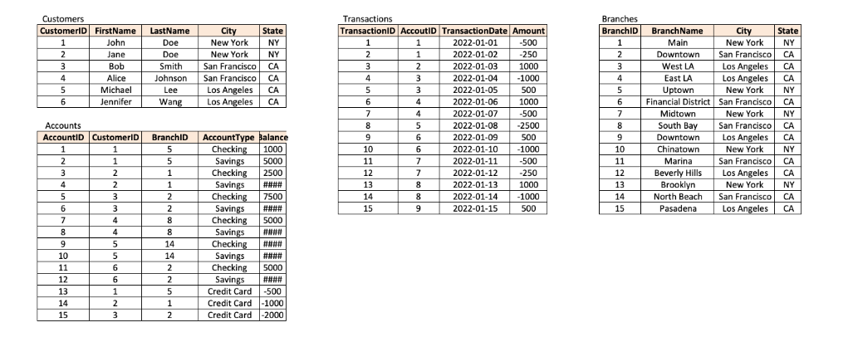
You are a Finance Analyst working for 'The Big Bank’
You have been tasked with finding out about your customers and their banking behaviour. Examine the accounts they hold and the type of transactions they make to develop greater insight into your customers
Tables

Slide 3
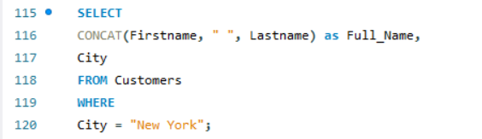
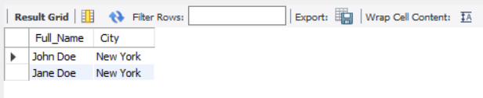
Question 1) What are the names of all the customers who live in New York?
INPUT
OUTPUT

Slide 4


Question 2) What is the total number of accounts in the Accounts table?
INPUT
OUTPUT

Slide 5
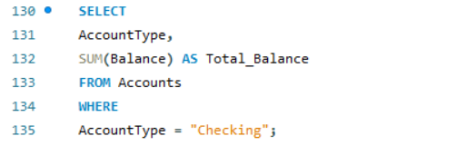

Question 3) What is the total balance of all checking accounts?
INPUT
OUTPUT

Slide 6
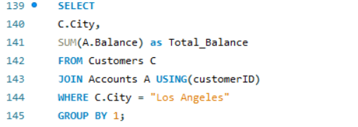

Question 4) What is the total balance of all accounts associated with customers who live in Los Angeles?
INPUT
OUTPUT

Slide 7
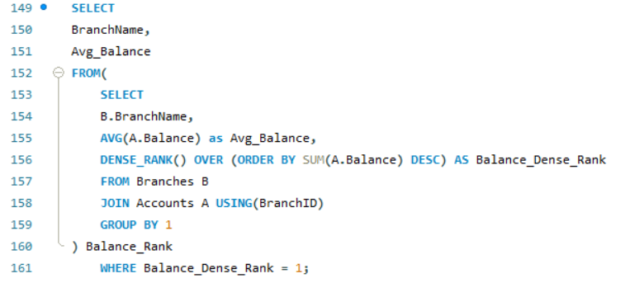

Question 5) Which branch has the highest average account balance?
INPUT
OUTPUT

Slide 8
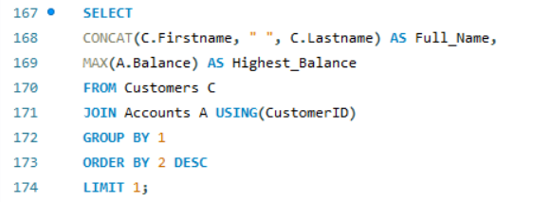

Question 6) Which customer has the highest current balance in their accounts?
INPUT
OUTPUT

Slide 9
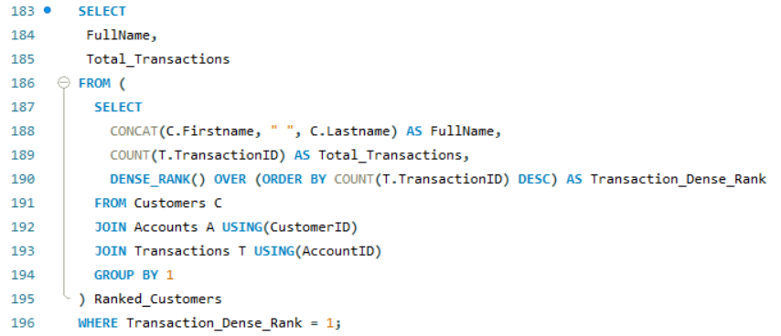
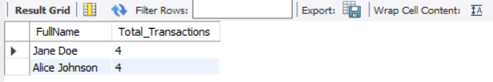
Question 7) Which customer has made the most transactions in the Transactions table?
INPUT
OUTPUT

Slide 10
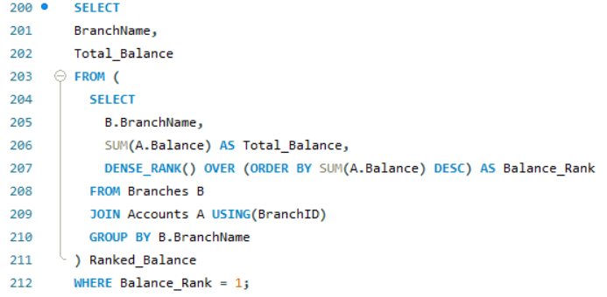

Question 8) Which branch has the highest total balance across all of its accounts?
INPUT
OUTPUT

Slide 11
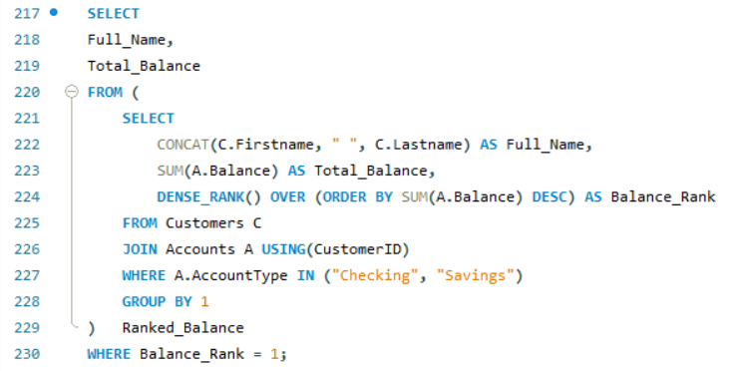

Question 9) Which customer has the highest total balance across all of their accounts, including savings and checking accounts?
INPUT
OUTPUT

Slide 12
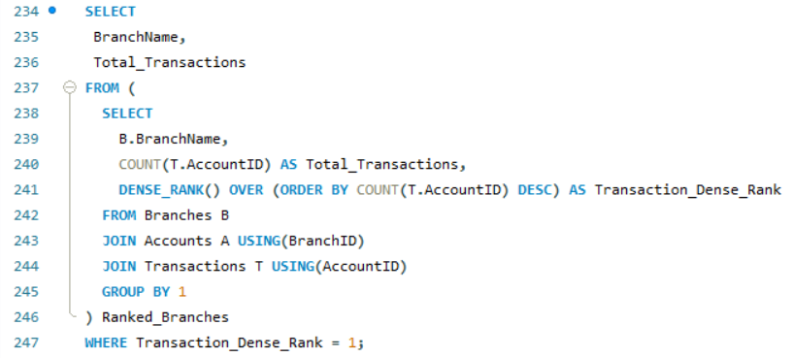
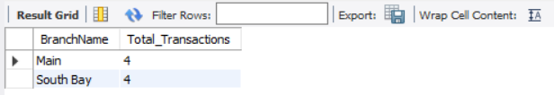
Question 10) Which branch has the highest number of transactions in the Transactions table?
INPUT
OUTPUT

Slide 13


Thank You
By Sebnem Basaran
sebnembasaran@outlook.com
Portfolio:
https://www.novypro.com/profile_projects/sebnembasaran
Github:
https://github.com/sebnembasaran?tab=repositories

